Slide 1
Improving Blind Spot Denoising for Microscopy
Group no.2
Syeda Qurat ul Ain Naqvi
Sonali Godavarthy
Zakriya Shakeel

Slide 2
What is Denoising?
Computer Vision Task
To remove or reduce noise from an image
Removal of unwanted artifacts from signals and images
Sources of noise: Poor lightening conditions, limitation in imaging equipment, Vibration or motion, etc
Types of noise: Gaussian Noise, Poisson Noise, Salt-and-Pepper Noise

Slide 3
Introduction
Self Supervised Denoising approach
Unpaired noisy image dataset
Paired noisy image training is bottleneck. Because having clean images data is difficult.
Clean Image is finding the right exposure and light intensity
Maximize the Signal to Noise Ratio (SNR)
Minimize the undesired effects like phototoxity
Supervised Learning -> CARE, Noise2Noise
Self-Supervised Learning -> Noise2Void, Noise2Self
Outputs a phantom image which is deconvolved result

Slide 4
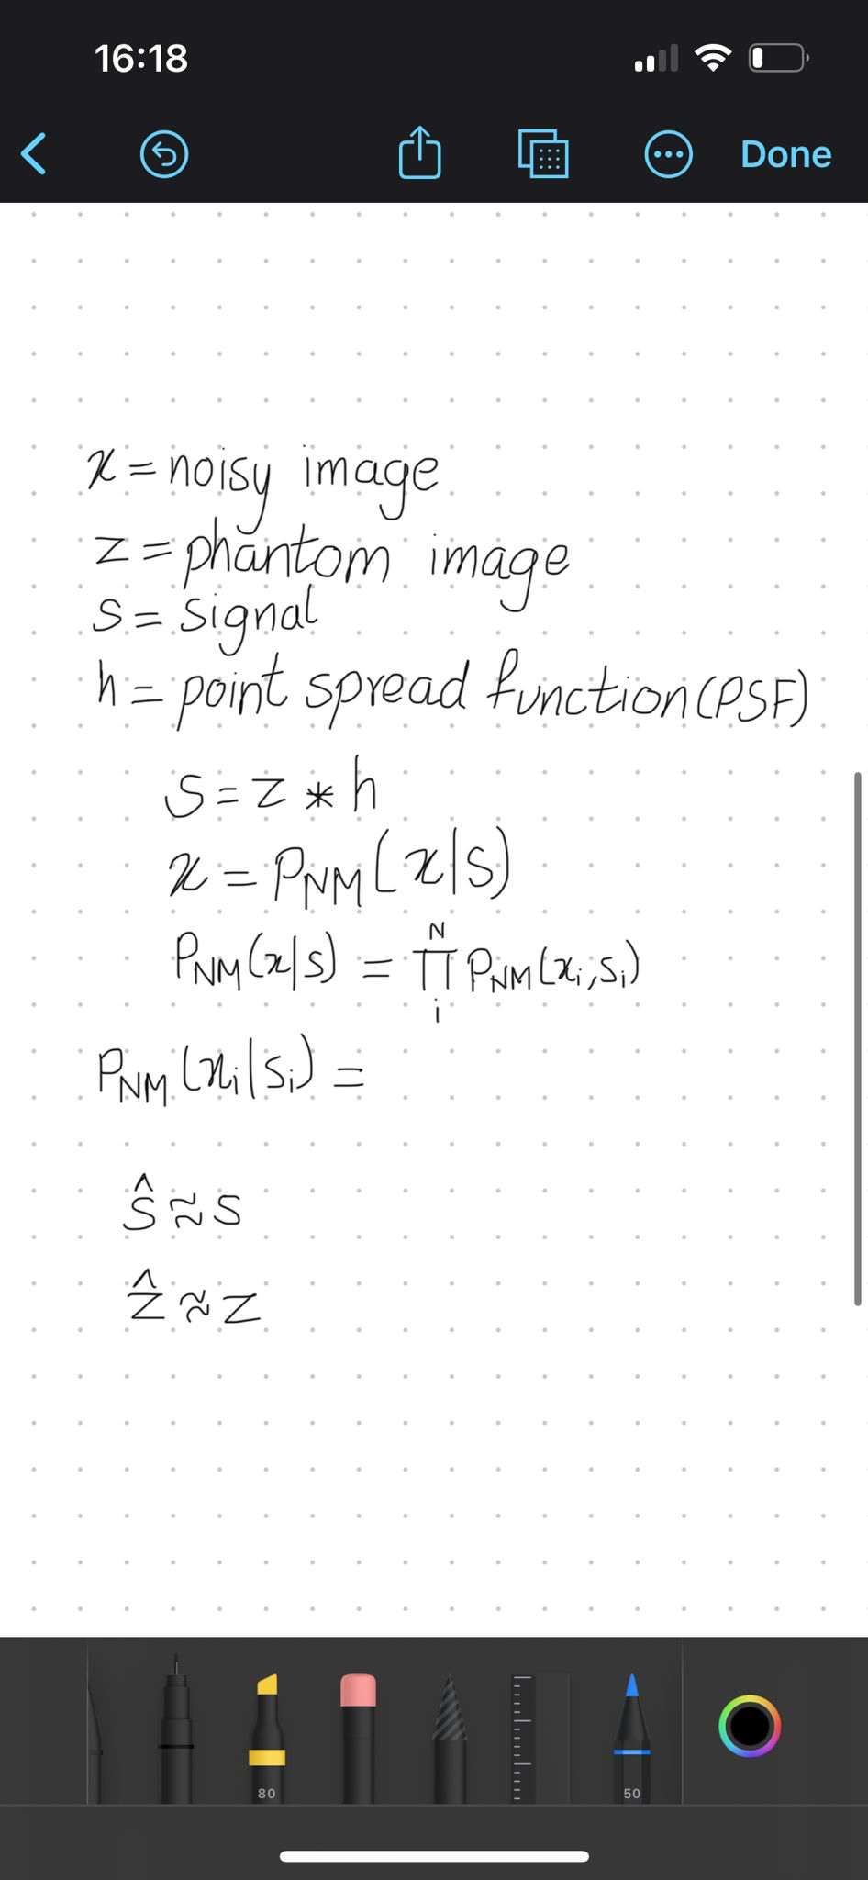
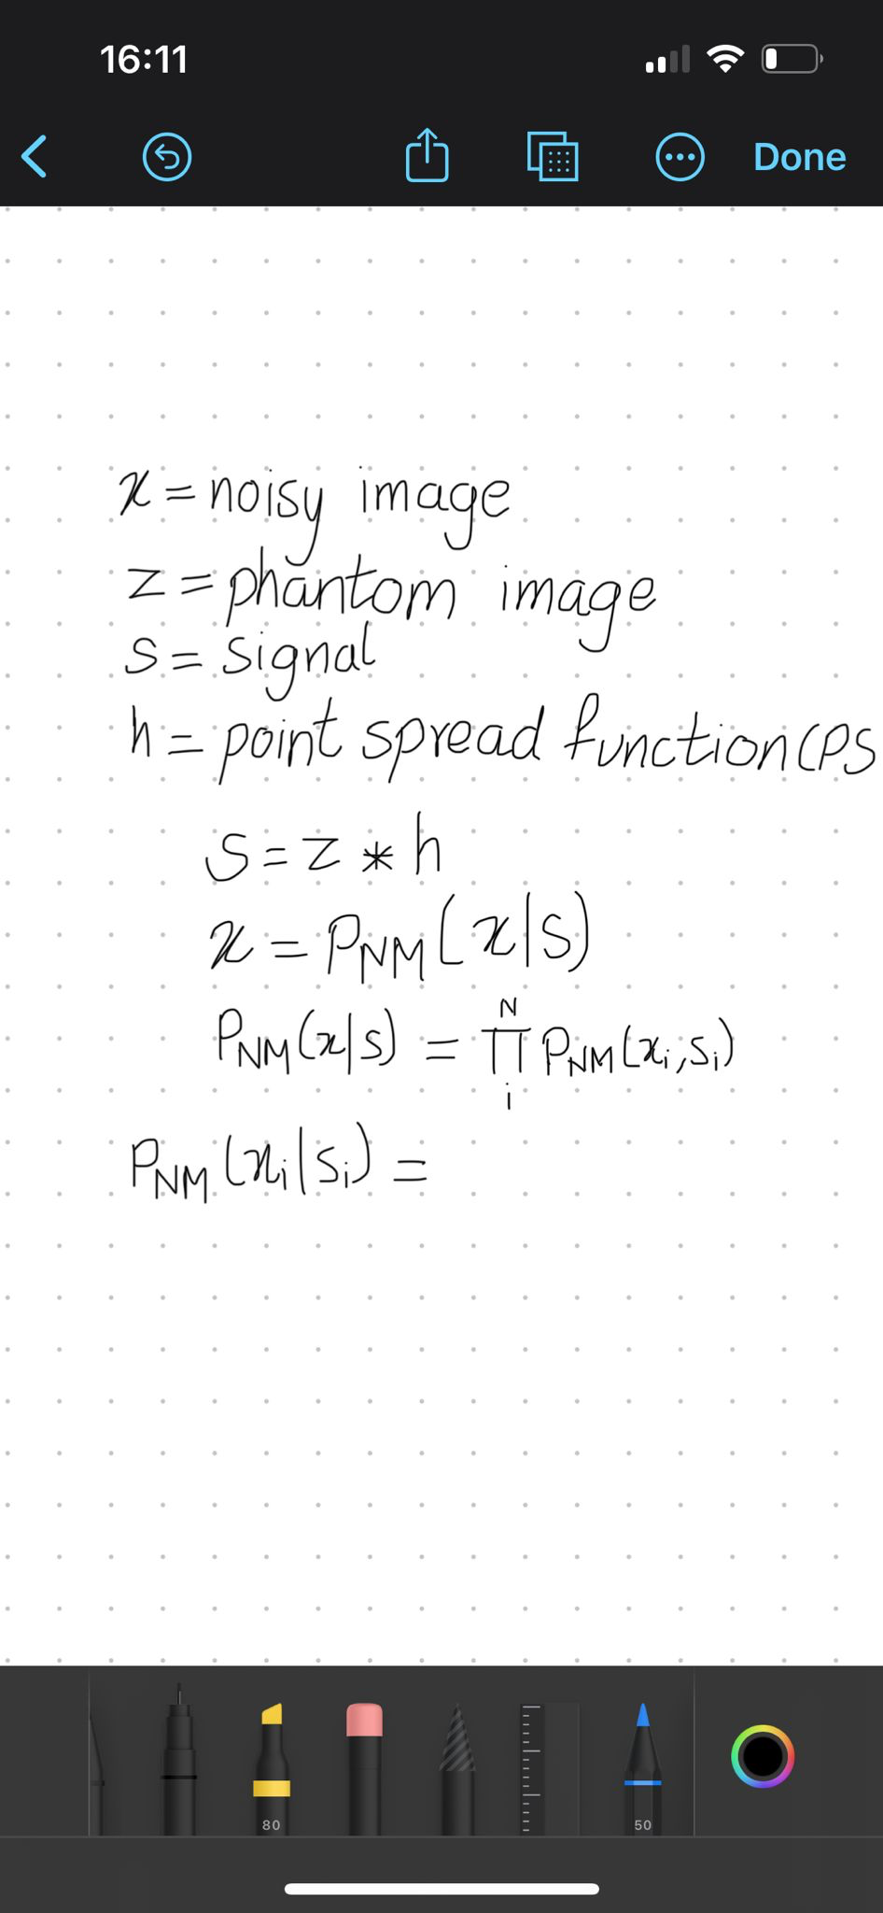
Architecture
1) True Signal – Result of Convolution (assumed)
2) Deconvolution
3) U-Net Architecture is used to predict Phantom Image
4) Convolution to produce final denoised result
5) Blind spot Masking
how likely it is to measure noisy value at pixel i given the underlying signal

Slide 5
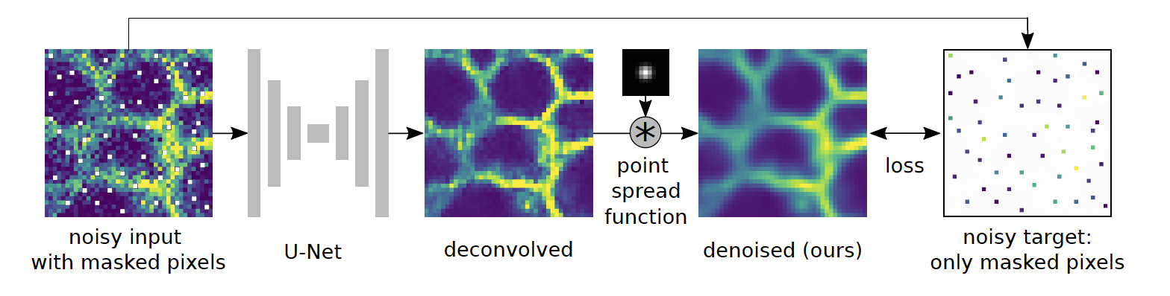
Phantom Image – unknown distribution of excited fluorophores
Signal – phantom image maps through optics of microscope and formals image on detector
Denoising task estimates
Deconvolution estimates
Architecture of Noise2Void with PSF [1]

Slide 6
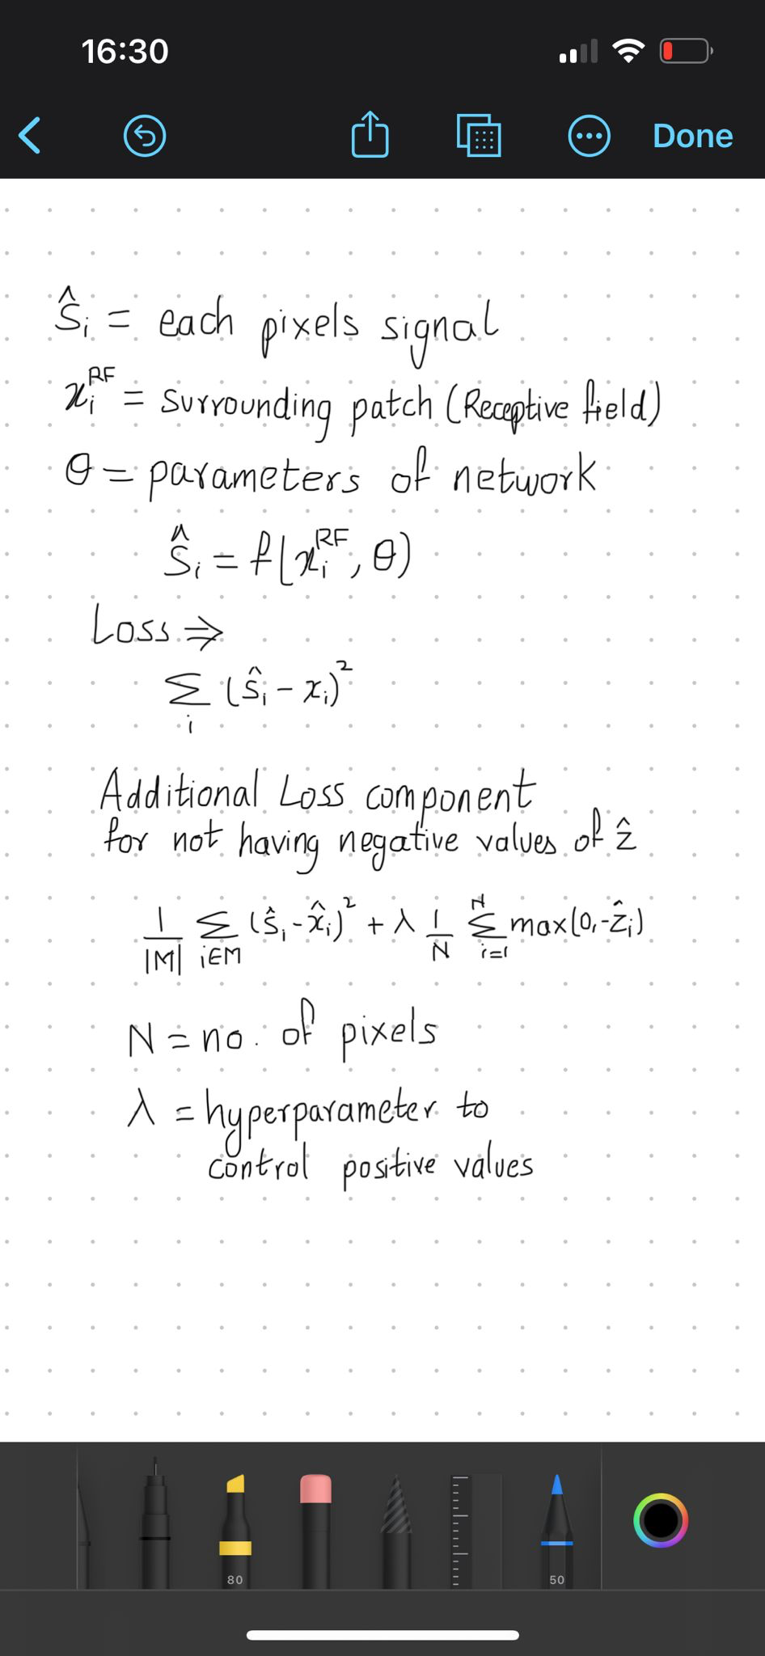
Blind Spot Denoising:
Loss computed for random pixels and these pixels are masked in the input image by replacing their values to random pixel value. It acts if it had blind spot Receptive field, helps in denoising image.
High frequencies must be drastically reduced or removed. To avoid getting high frequency artifacts in blind spot methods, a convolution with PSF is added after the U-Net
Constraint for Deconvolved Image:

Slide 7
Experimental Setup
Datasets used: Convallaria, Mouse Chain, Mouse and Flywing
Gaussian noise with standard deviation 20, 70 added to Mouse and flywing dataset respectively.
PSF is determined using random text data images
Gaussian PSF with standard deviation 1 added pixel-wise
Hyperparameters:
Epochs = 200
Learning rate = 0.001
batch size = 1
Positivity constraint = 1

Slide 8
Performance
Peak Signal to Noise Ratio (PSNR) is used to evaluate performance
With positivity constraint as 1, we get best visual results
With positivity constraint as 0, we get various artifacts such as random repeating, grid patterns, etc
Gaussian PSF with SD as 1 pixel width and Gaussian noise of SD 100 gives best results

Slide 9
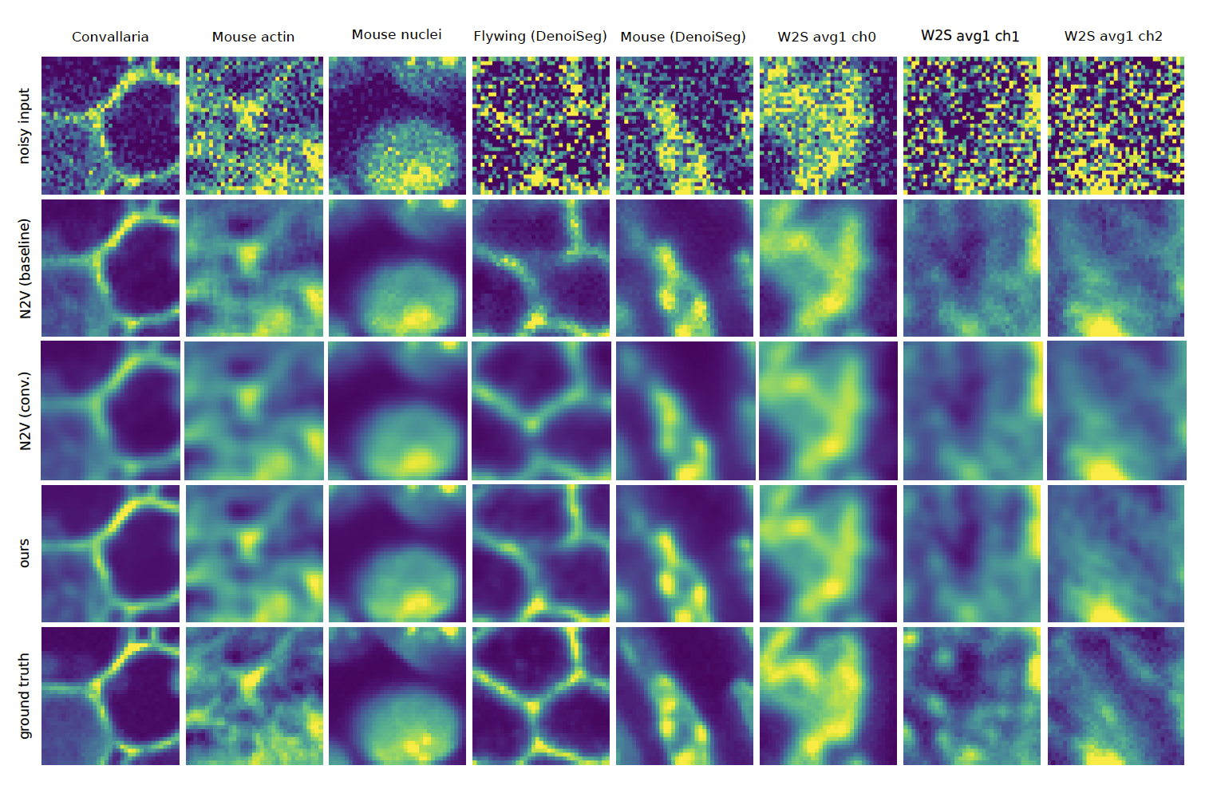
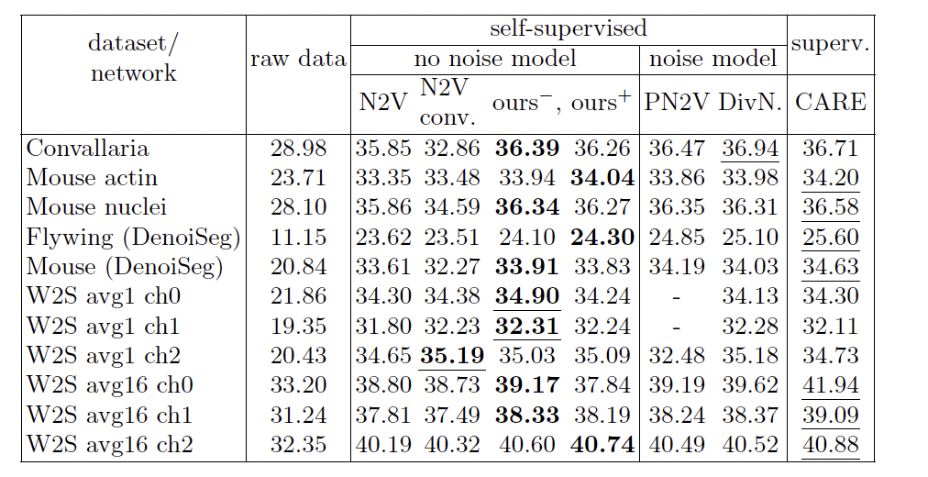
Results
Quantified Denoising Results [1]
Denoising Results [1]

Slide 10
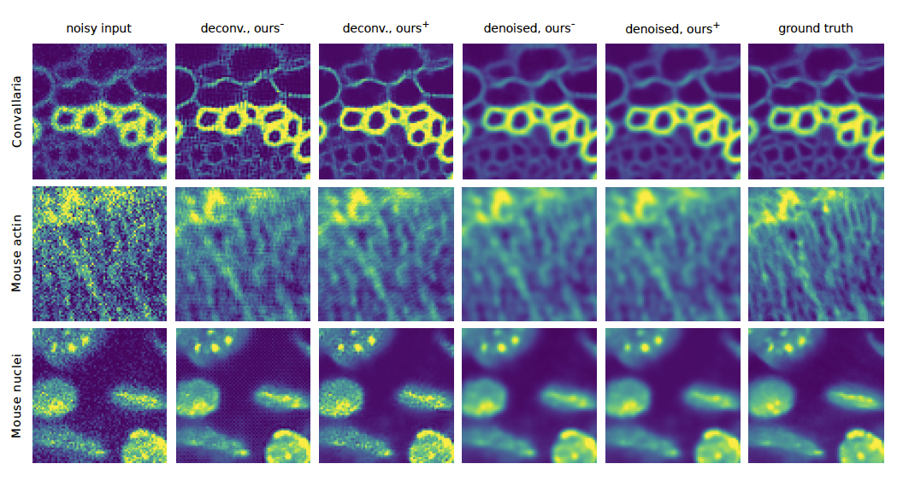
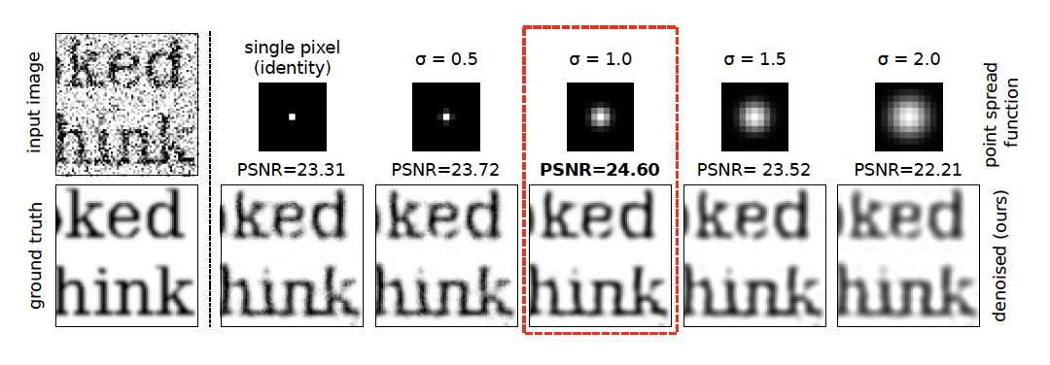
Effect of Positivity Constraint [1]
Effect of Point spread function Mismatch [1]

Slide 11
Conclusion
Self Supervised Learning for Denoising
Simple Architecture
Unpaired noisy image dataset training
No assumptions about noise
Outputs a phantom Image, which is deconvolution result
With positivity constraint as 1, we get best visual results
Gaussian PSF with SD as 1 pixel width and Gaussian noise of SD 100 gives best results

Slide 12
References
Goncharova, Anna S., et al. "Improving blind spot denoising for microscopy." European Conference on Computer Vision. Cham: Springer International Publishing, 2020.
https://paperswithcode.com/task/denoising#:~:text=Denoising%20is%20a%20task%20in,lighting%20conditions%2C%20and%20compression%20artifacts.
https://blogs.nvidia.com/blog/what-is-denoising/

Slide 13
THANK YOU

